Slide 1
Cloud Environment Manager
Group: sdmay21-39
Email: sdmay21-39@iastate.edu
Adis Osmankic
Gavin Monroe
Jet Jacobs
Rishabh Bansal
Zane Seuser

Slide 2
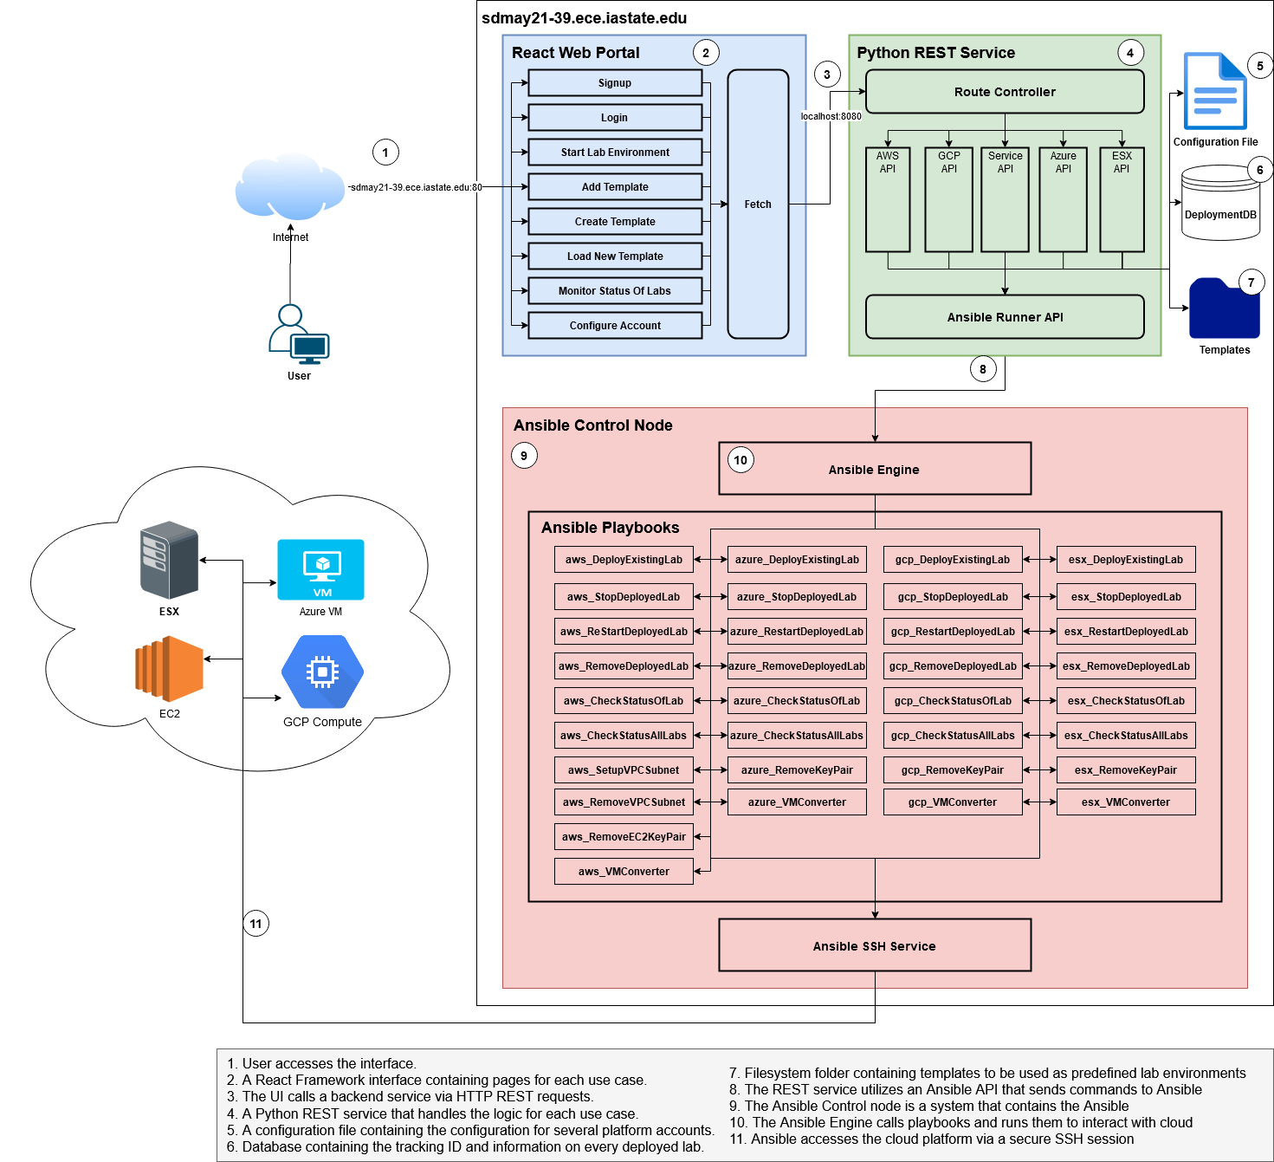
Project Description - Zane
Notes:
Currently, our sponsor provisions lab environments for capture the flag events within a variety of cloud providers and on-premise resources by hand. The problem with this is that it is super unscalable. They have no way to quickly create and manage a large amount of lab environments. There is also no way to easily make sure that all these environments are the same. Right now, they have to log in to each individual cloud provider (like AWS, Azure, GCP, etc.) and manually configure every single virtual environment individually.
By developing our project, the Cloud Environment Manager application, we are going to provide our sponsor with a clean and simple user interface that allows them to quickly and easily deploy lab environments to multiple different cloud providers. The application will also allow them to manage and destroy their existing lab environments once they are no longer needed.
So, in a nutshell, our whole project is to create a user friendly interface that can quickly and easily create and manage virtual machines in various cloud platforms.

Slide 3
Current Technical Challenges- Rishabh
Integrating Multiple Cloud Platforms
Getting frontend connected with backend
Tie all the components together to create a seamless experience
Notes:
Hi So one of the most current technical challenges we are facing is Integrating multiple Cloud Platforms. So basically we are using cloud platforms like GCP, Azure and AWS. We are Getting familiar to all the cloud platforms and getting that worked is kinda challenging for now. So far we are still trying to understand things better and getting more testing done on it. Further in between we also faced Challenges while connecting our frontend with backend, but with more testing we are also trying to solve this issue and getting more confident of getting this worked. Further we are facing problem to tie each components up all together and definitely trying to break this out into smaller pieces and getting it tested as frequent as possible.

Slide 4
Standards - Adis
Development
REST
DevOps CI/CD
Testing
Security
OWASP ASVS
NIST Cybersecurity Framework
Integrity
Notes:
For our product, we are following many different standards setup by different organizations and entities to create a compliant application ready for the real world. We can divide it up into two main categories, the development and implementation of the code and the security standards we are implementing.
Seeing as we have a webpage frontend and a separate web service acting as our backend, we decided to create a REST API meaning we needed to follow REST standards for our backend service and how the two applications communicate with each other. Although REST can be considered more of an architectural style, there are a set of standards that make a REST service usable with other applications and usable with different frameworks that allow for interoperability and scalability.
We are following IEEE14764 and IEEE 12207 standards which basically explains the life cycle processes of software. This is where our CI/CD and DevOps practices come into play. We maintain our application and follow these standards to confirm that we are following the recommended process of maintaining the life cycle of our software both during development and after deployment.
We also follow the IEEE 29119 set of standards which defines software testing. For an application to be successful, it needs to work as expected. The easiest way to make sure its working as expected is to create automated tests. We test all of our non static processes and document that in our team documentation pages. To confirm changing one component does not cause other components to fail.
Now for some security standards.
We follow they OWASP Application security verification standards, which is a set of standards for testing the security of an application to ensure the safety of the application for both the user and the systems the application may access. For every web application, it is the duty of the developers to ensure that the application is safe to some degree, which is why we follow this set of standards.
Next we follow NIST’s general cybersecurity standards. NIST is the national institute of standards and technology and their set of cybersecurity standards basically are a set of standards based on best practices from several sources along with contributions from the online community. We follow these standards to, once again, ensure the safety of our users and our applications and to prepare our application for usage by organizations.
Finally we are conforming to the IEEE 15026 set of standards which basically go over software assurances. We are specifically following part three of this standard which goes over the integrity a given piece of software. We consider the CIA triad of Confidentiality, integrity, and availability of our application with great importance and following this standard is a critical step to achieving this.

Slide 5
Engineering Constraints - Jet
We were given full control
No access to an ESX system
No budget, so all examples have been made with free tiers of AWS, GCP, Azure
Time in semester
Project will be open source so this will be mitigated more
Project will be open source ( constraint ? )
Any operation we use must be compatible across all platforms
Notes:
As far as Engineering constraints go our team have very few. We were largely given control of all the implementation details, like language choice, libraries, frameworks, tool sets, and deployment strategies. PWC did give us a push in the direction of using ansible or chef to perform deployment functionality; ansible did already seem to be the correct choice to manage our functionality across the required cloud platforms. So, while it’s technically a constraint it was really just a smart decision about our toolset made at jump.
Moving into the more concrete constraints. We weren’t provided with an ESX set up, so developing against it for the supported functionality is largely impractical, and as such has taken a back burner to the functionality of the other platforms.
Another, constraint is that we were also given no budget. We largely do all development using free tiers of AWS, GCP, and Azure. This hasn’t restricted us so far, but I could imagine it becoming a problem with more advanced functionality requiring higher tiers for the listed platforms. This then becomes multiplicative, a tier per platform; no surprise, but it would ultimately require some kind of investment.
The project is open source, this being a constraint is kind of a hot take on the downsides of open source. Open source is a bit of a double edged sword, since long term you could drive adoption and get some good dev resources all for the low low price of $0. But, in the short term you can’t depend on institutional knowledge like in a more traditional project, with a business owned code base. This means that there won’t always be some expert in a particular area of the application. Now, since there is no expert if a bug occurs in this area, it could take more time to fix since the developer will also need to contextualize that area of the program. When this happens development can become stagnate, or the project orphaned. This does have the effect of pushing us into a more well documented style of development, which will aid in the hand off between us and pwc.
Lastly, and probably the most important constraint is that any functionality we add must occur across all supported platforms. This while going hand and hand with our requirements, means that even if we could implement a desired feature for one platform if we can’t support it with the others, it shouldn’t be added.
Wrapping up the constraints we will move on the the requirements.
### Not Spoken ###
Cloud Budget (need to stay on free tiers) (No Budget), Time constraint, Must conform to different cloud environments standards and syntax (Jet)

Slide 6
Engineering Requirements - Gavin
Non Functional VS Functional
Requirements
We have two different types of Engineering Requirements:
Notes:
Talk for about two minutes
We decided to split this slide into two categories (Functionaly and non functional) (see below). Just go over what is required for this product and try and fill for 2 min.
NF:
Easy to use
Easy to implement
Easy integration
Open Source
Documented well
F:
Create a cross platform application that manages different cloud platforms
Features:
Modular cloud management
View status
Create VM environments
Manage VM Environments
Uni deployments

Slide 7
Non Functional Engineering Requirements - Gavin
All in terms of Client Needs and Open Source ->
Ease of Use - how the easy is it for the end user to use the product
Ease of Implementation - how easy is it to deploy the product
Level of Documentation - how easy is it to understand and interpret the software
Reliability - is it designed for the future
Availability - how easy is it to get the product (gitlab/github)
Notes:
Talk for about two minutes
We decided to split this slide into two categories (Functionaly and non functional) (see below). Just go over what is required for this product and try and fill for 2 min.
NF:
Easy to use
Easy to implement
Easy integration
Open Source
Documented well
F:
Create a cross platform application that manages different cloud platforms
Features:
Modular cloud management
View status
Create VM environments
Manage VM Environments
Uni deployments

Slide 8
Functional Engineering Requirements - Gavin
All in terms of Client Needs and Open Source ->
Cloud Compatibility - needs to implement cloud compatibility and integration with AWS, GCP, and Azure
Cloud Management - manage cloud server instances for creating, deploying, etc, VM Envs.
Cloud Information - provide information on VM environments.
Centralized Platform - one place to manage all these VM environments.
Notes:
Talk for about two minutes
We decided to split this slide into two categories (Functionaly and non functional) (see below). Just go over what is required for this product and try and fill for 2 min.
NF:
Easy to use
Easy to implement
Easy integration
Open Source
Documented well
F:
Create a cross platform application that manages different cloud platforms
Features:
Modular cloud management
View status
Create VM environments
Manage VM Environments
Uni deployments

Slide 9
Questions?
Notes:
Gavin just ask for questions

