Slide 1
Cloud Environment Manager
Group: sdmay21-39
Email: sdmay21-39@iastate.edu
Adis Osmankic - Leader
Gavin Monroe - Meeting Scribe
Jet Jacobs - System Architect
Rishabh Bansal - Report Manager
Zane Seuser - Cloud Architect
Notes:
We are team 39
I’m Jet Jacobs, and I’ll have everyone else introduce themselves.

Slide 2
The Problem - Jet
Client Need
Deploy multiple environments across several cloud platforms
Environments may consist of several machines
Environments will be spun up and down at will
Third parties will access these
Collected reqs
Secure (i.e. limit access to an environment to a set of users)
Easy to use (making the system complex doesn’t really solve the problem)
Reliable (needs to be available since start and shutdown times are unknown)
Able to track resource consumption
Notes:
Jumping right in to our problem,
Our Client, PWC expressed that they currently host, CTF lab environments, as well as training machines. These environments are often the same, apps, os, etc, but require some manual effort to spin them up, and tear them down. These lab environments get even more complex when taking into account that there may be several machines, with networking between them. These labs may be spun up in different cloud providers, GCP, Azure, AWS, etc. This ends up costing them serious dev time, and compute resources.
The major complexity comes from the cross cloud provider support, since each cloud provider has tools available for this sort of management, but not necessarily cross cloud providers.
Outside of the concerns they expressed we also gathered other concerns.
Third party access
CTF teams will need access to resources, but shouldn’t spin up environments
Usable
Should be easy to use both internally and as a participant in CTFs
Available
These resources should be accessible, and able to be spun up and down at a whim based on utilization
Traceable
These resources should be able to be monitored so they can determine use
-------------And I’ll pass it of to Adis who will talk more about our approach----------------

Slide 3
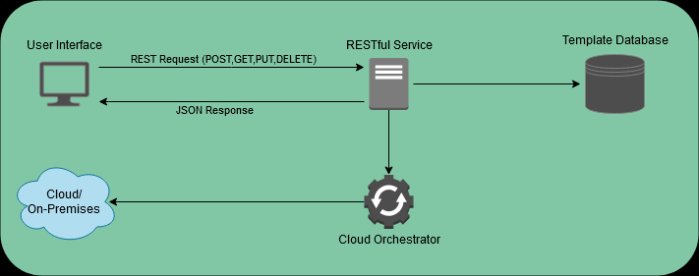
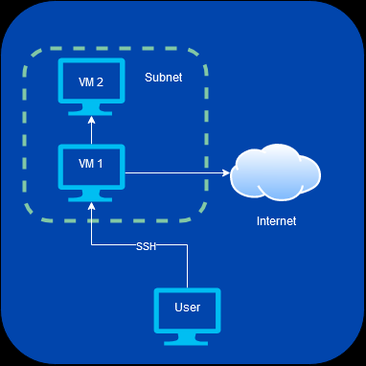
Our Solution - Adis
Modularity
Ability to manage different platforms
Usability
Intuitive design
Simple user input
{
"_id": "$UUID",
"name": "$string",
"creation_date": "$date",
"required_subnet": "$boolean",
"amount_of_machines" : "$integer",
"virtual_machines": [
{
"name": "$string",
"machine_id": "$string",
"internet_access": "$boolean",
"ssh": "$boolean",
"instance_type": "$string",
"number_of_instances": "$integer"
}
]
}
Notes:
Adis: To solve these problems, we needed to create a tool that is versatile and modular enough to work on several platforms, yet intuitive and simple enough for the user to comfortably use it. This led us to the idea that we needed to make a full (CLICK) stack application that is capable of managing different cloud and on premises environments without sacrificing usability.
So what exactly is this tool going to do? This tool will be a packaged full stack application that the targeted consumers (System Admins and CTF hosts) can install and connect to their cloud or on premises virtual machine distribution service. It will be able to connect to the three major cloud platforms, GCP, Azure, and AWS along with ESX for on prem systems.
It will be able to create, remove, and manage every virtual machine deployed to each platform all in one place without sacrificing modularity. In other words, when the user wants to deploy the same virtual machine to a different platform, it should be the same exact process. We accomplish this modularity by utilizing generic templates (Click) that the administrator is allowed to create.
These templates contain generic information provided by the administrator that our tool will be able to consume and use to deploy machines to each platform. The information in these templates range from what machine image you want to how to setup the network of the environment.
The customizability of these templates gives our end-user the ability to fully manage their platforms in a consistent and easy way. The ability to customize the network (Click) is especially critical to our end-user as this dictates who can access the machine along with what can the machine access. This solves critical security concerns of accidently exposing a machine intended to be internal to the public or accidently exposing a malicious machine to other machines on the platform.
Now that you have a general idea of what our solution is, lets go over the technical parts of how we are creating this tool.

Slide 4
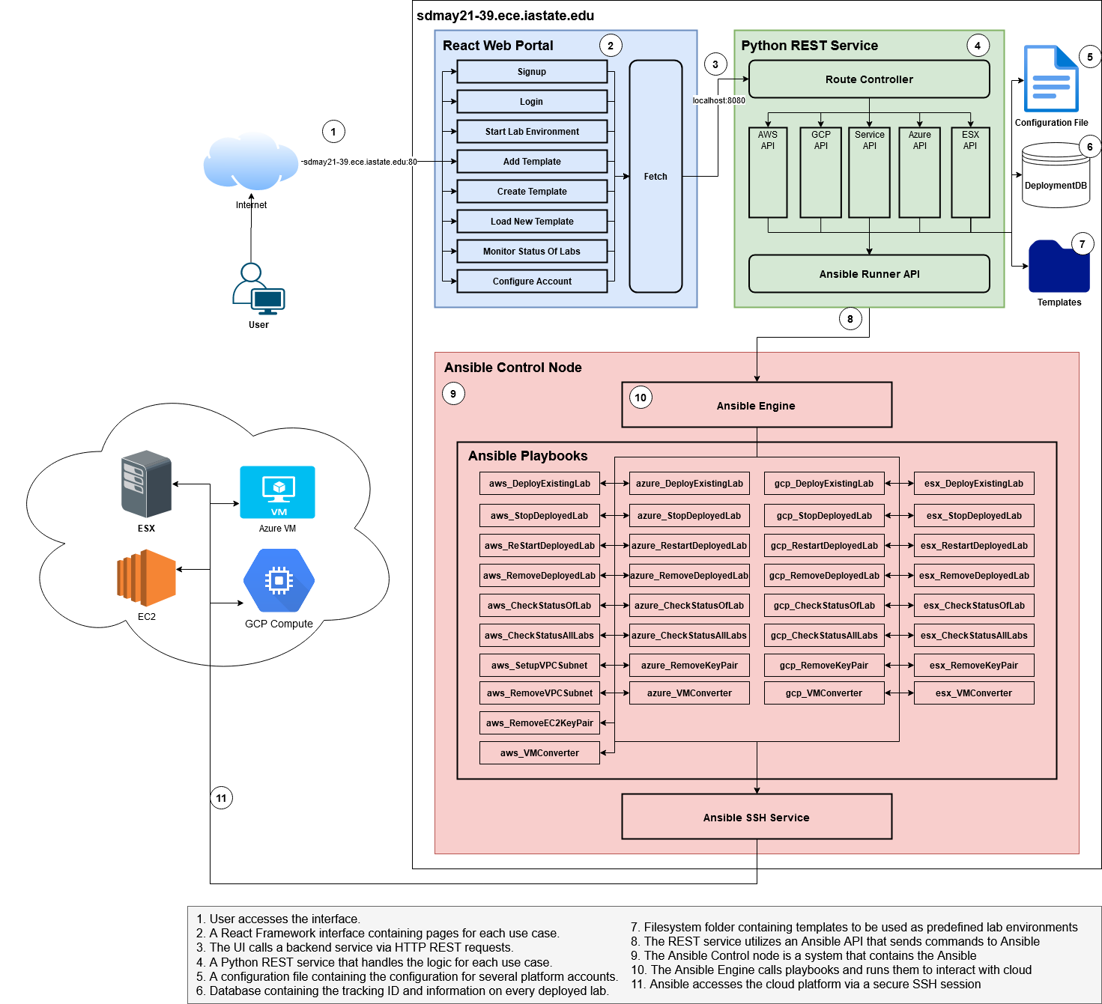
Our Solution - Zane
3 Main Components
React Front-End
Flask Back-End
MongoDB
Ansible Playbooks
Cloud Providers
Notes:
Zane:
Cool, so the solution to our sponsor’s problem can be broken down into 3 main components: the React front-end, the Flask back-end, and the various cloud providers they want to provision lab environments into.
We are aiming for our React front-end to be an intuitive, easy-to-use management interface of both lab templates and lab environments. Templates are reusable lab configurations for the various cloud providers. You can think about them as the starting point to be able to provision either 1 or many different labs. The lab environments themselves are the actual machines or instances that are being provisioned from the templates into the the various cloud providers like AWS, GCP, etc. Our users will be able to quickly and easily view, create, and delete both lab templates and environments via the React front-end.
Our Flask back-end (written in Python) will be providing all of the API endpoints necessary to perform the actions provided to the user on the front-end. A few examples of these actions are a DELETE to remove a template from the application, a GET to retrieve all provisioned labs, and a POST to provision a lab.
The database we chose to use for this project is MongoDB. We chose to go this route because of the extreme flexibility, and the easy integration with Python, which, as mentioned above, is what our back-end is written in.
Finally, the way that we are provisioning resources into all the different cloud providers is through Ansible. We are in the process of writing a multitude of Ansible Playbooks that, when called by our Flask API, will be able to retrieve, provision, and de-provision resources within any cloud environment that we need to.

Slide 5
Goals for semester - Rishabh
Main Objective- Web application that Quickly create and manage a large amount of lab environments.
Goals for Semester to Achieve the Objective -
Application to be hosted in AWS (Amazon Web Services)
Hook Ansible to some backend call
Configure automation scripts
Create Azure Ansible Playbooks
Notes:
What we are trying to get down. What is our MVP and probably how we are achieving this. Jira stuff
So By developing the Cloud Environment Manager application, we aim to provide our client PwC with a clean and simple user interface that allows them to quickly and easily deploy lab environments to their desired cloud providers. The application will also allow them to manage and destroy their existing lab environments once they are no longer needed. Some of the major goals that are designed for this semester are that we need to have our application to be hosted in AWS. Further we would be working on how we would be able to hook are Ansible to some of the backend calls. Further configure the scripts to be run dynamically for the project. And lastly we would be having playbooks that deploy and manage a given GCP environment. The playbooks must be including Create Lab, Remove Lab, Shutdown/Restart lab and many more.

Slide 6
Technical Challenges - Gavin
Main Technical Challenge- Creating a full-stack web application that creates and manages a large amount of lab environments.
Some of the Technical Challenges for the Semester -
Creating a back-end that fully communicates with 3rd Party Cloud Services.
Creating a Frontend that updates in real-time to show info about the environment.
Implementing Ansible for our backend.
Tie all of these components together to create a seamless experience.
Notes:
Notes for Gavin:
Challenges we had… Complexities of making a modular product that can manage several cloud environments and making it seemless for end user. Trying to connect different technologies together that none of us are fully familiar with. More stuff like that

Slide 7
Questions?
Notes:
Gavin just ask for questions

