Slide 1
Cloud Environment Manager
Team: sdmay21-39
Sponsor: PwC
Adviser: Lotfi Ben Othmane

Slide 2
Problem Statement - Rishabh
Currently
Our sponsor, PwC, provisions lab environments for security events within a variety of cloud providers and on-premise resources by hand.
Goal
By developing the Cloud Environment Manager application, we provided PwC with a clean and simple user interface that allows them to quickly and easily deploy lab environments to their desired cloud providers. The application will also allow them to manage and destroy their existing lab environments once they are no longer needed.
Notes:
Currently, our sponsor provides lab environments for a variety of reasons such as capture the flag events or to test different tool sets in a simulated environment on a variety of cloud providers manually. The problem they have is that this method is unscalable and it is difficult to recreate these environments, especially on different platforms. They currently have no way to quickly create and manage a large amount of lab environments in a consistent and reliable way.
Through our project,, the Cloud Environment Manager, we created an open source application that our sponsor and others with similar problems can utilize. We provided an application that contains a clean and simple user interface that allows them to quickly and easily deploy labs and manage environments on multiple cloud providers.

Slide 3
Functional Requirements - Rishabh
A user should be able to view a list of existing lab environments
A user should be able to view the status of existing lab environments
A user should be able to create lab environments within AWS, GCP, and Azure
A user should be able to destroy existing lab environments
Notes:
Rishabh- In this project are having both functional and nonfunctional requirements. For functional requirement user would also be able to view the list of existing lab environments deployed. We give user a full flexibility to choose their lab environment between the AWS, Google cloud platform and Azure.

Slide 4
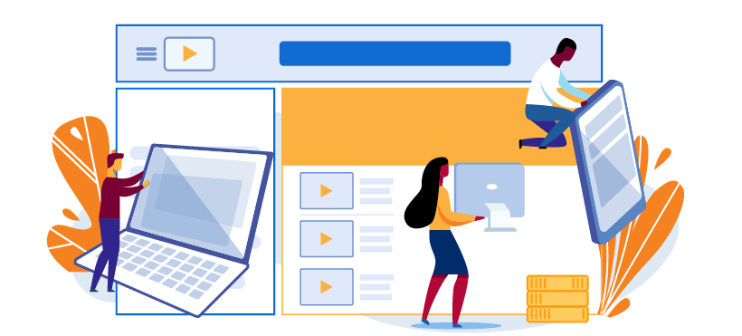
Non- Functional Requirements - Rishabh
The application should be available at all times.
The application should have no wait time to load the pages
The application should properly handle errors behind-the-scenes
The user interface should be visually appealing
The user interface should be easy to use
Notes:
Moving Forward with Non Functional Requirement. As our application will be first utilized by our client, and then a larger user base, there are various non-functional requirements that are important to the success of our project. We will made sure to have our application available all time to the user. We also made sure that there would be no wait time for pages to be loaded. The next most important thing in any application is the interface. We made our interface appealing to the user and would be easy to use by them.

Slide 5
Project Vision
Intuitive
Scalable
Modular
Notes:
Hi, my name is Zane Seuser and I’m a software engineering major.
Throughout this presentation you will likely hear us refer to “labs” or “lab environments”. In the context of our project, the Cloud Environment Manager application, a lab or lab environment is a group of one or more virtual machines that are hosted within a cloud provider.
Our project needed to be intuitive for the user to utilize. It also needed to be modular and scalable enough to perform multiple deployments across multiple platforms.

Slide 6
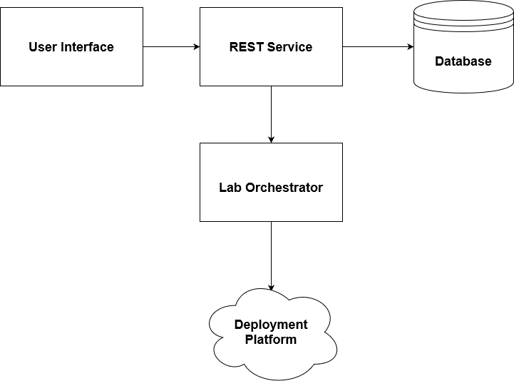
Design Overview
Notes:
To make the core functionality accessible to the user, we decided that we needed a user interface that is separate from the complex logic and processing necessary for our application. This allowed for users to be able to easily view and manage information such as templates and deployments.
We also needed to have a REST service that could handle requests from the user interface, store and retrieve data from our database, and communicate with our cloud orchestrator in order to turn the lab templates into actual deployed virtual machines in on the different cloud platforms.
Another thing we required was the ability to store information about how to deploy to specific accounts, store templates, and store information on deployed labs. We decided that, in order to allow for easy modification of data, to go with a NoSQL database to store all this information.
Finally, we decided to utilize a third-party automation software as our cloud orchestrator. Utilizing third-party software allowed for consistent data to be utilized across each platform and was relatively quick to implement.

Slide 7
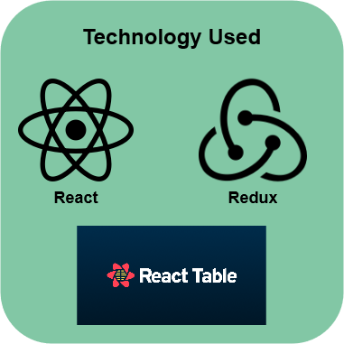
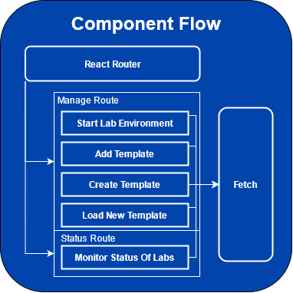
Frontend Implementation
Notes:
Gavin Monroe - Software Engineer Major
Let’s hop into our implementation starting with the frontend.
The frontend needs to be robust enough to handle our many different features, yet user-friendly enough for our users to easily navigate and control the application.
Naturally we went with a graphical web interface that can be hosted by the application owner to expose the frontend to their users.
Technology-wise we utilized react redux to handle our state management, react router to set and handle routes, and react table to handle the display of data.
The frontend contains three main routes, a Home Route that displays basic information of the application, a Manage Route that handles the management of labs, and finally a Status Route to display currently deployed labs and saved templates. The web application then makes REST requests to our backend REST API.

Slide 8
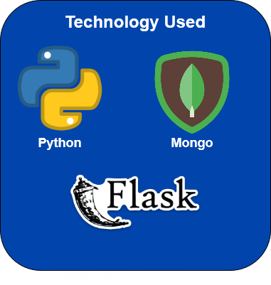
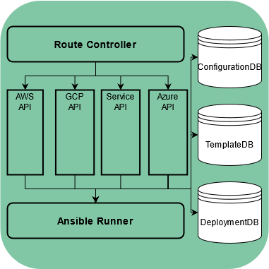
Backend Implementation
Notes:
Gavin
Going on to the backend implementation
For the backend, we decided to utilize python as the language of choice. This is mostly due to the fact that python has libraries that interface with our other technologies, such as our database, mongoDB, and our cloud orc-a-strator, Ansible.
To allow our backend to communicate with our frontend, we exposed a REST API utilizing the Python-Flask library.
To store information on our deployments, save our user’s templates, and to store the user’s account information for each cloud platform, we utilized mongoDB.
We decided to go with mongoDB since it was a common “No-SQL” database and much of the data we are storing, becomes unstructured due to the several cloud environments we are utilizing or that our user plans to add.

Slide 9
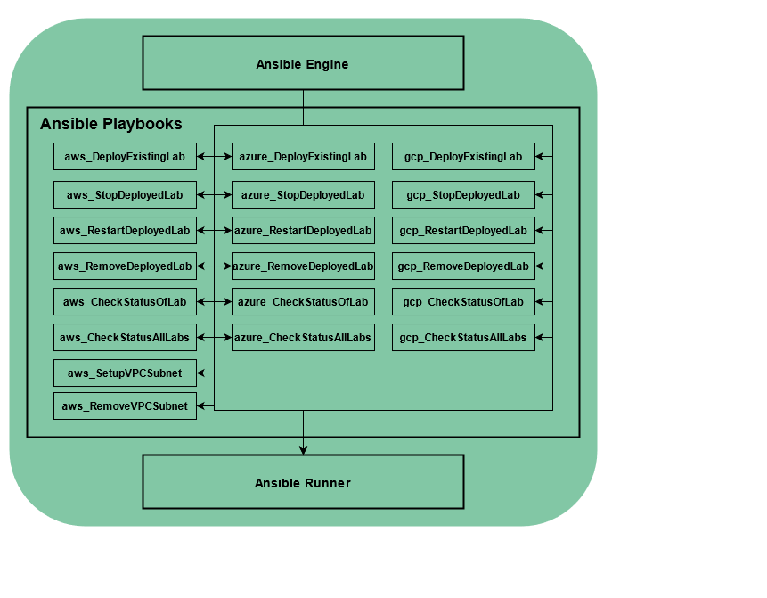
Cloud Orchestrator
Notes:
Gavin
Going to our Cloud Orchestrator
When we were in our early design process, we debated which orc-a-strator to utilize. We could create our own python libraries that interface with each platform, but that introduced complexities and extra security concerns that we could not account for given our strict time constraints.
We decided to use a pre built tool for this and experimented tools such as puppet, chef, and terraform, but ultimately decided to utilize Ansible.
To utilize Ansible, we created several playbooks that perform some basic functionality, such as creating a specified network or virtual machine on a specified platform or even changing the state of some machines, then our backend service would utilize the ansible runner library, to finally run these said playbooks in whatever specified order they need to be ran.

Slide 10
Security
OWASP Top 10
CIA
Credential Vault
Extensive Logging
Limited Access
Notes:
Adis
Since this application requires authentication for each platform the user utilizes, the security of our product is of the utmost importance. Failure to secure this information can potentially expose user information to some actor, could allow some actor to provision malicious machines on a secured cloud network or may provision beyond the maximum number of instances for a given account, over charging the user’s cloud bill.
Since this is a web application, we followed the OWASP guidelines to assure that we accounted for each of the OWASP top 10 and in general we follow the CIA triad of confidentiality, integrity, and availability to help assure that our application is secure.
First and foremost, we have credentials that we need to protect, so we utilize ansible vault to encrypt our credentials using AES 256 encryption. This is handled via our ansible engine so our python service will never be exposed to this information making it impossible to leak these credentials in the python service.
We attempt to log as much useful information on the backend that we can and serve this to the application owner to enable them to forward this to some other logging mechanism or to enable monitoring on this system. This is important since the lack of logging/monitoring has consistently been on the OWASP top ten for several years.
We currently do not utilize https traffic due to our limited resources and time, but we recognize the importance of this and enabled a path that would allow this to be implemented in the future. Since we interact with data that is entered into a database, we sanitize and validate all input received on the backend and never directly query the database with a string.
Since the frontend also dynamically displays information based on input data, we sanitize and validate information received from any fetch call to prevent a malicious actor from loading or redirecting the user to malicous links or components in the case that the actor is able to replicate our API and attempt to perform a man in the middle attack.
Finally the backend currently requires a generated JWT token to perform any request to guarantee the request is from a valid user. Keeping the integrity of the application is fairly straightforward. We check that the user is authenticated, if they are they are allowed to create and manage lab environments on only networks and platforms that are associated with the cloud environment manager.

Slide 11
Demo
Notes:
Demo Link: https://vimeo.com/541361535/c636a980ed

Slide 12
Lessons Learned
Microservices are a tool not a challenge to overcome
Infrastructure is critical and costly
Notes:
So, there are a lot of lessons we, as a team, learned. Some were decisions that we made early on and now regret, others are more about the dev cycle, and what goes into being on a team.
Starting off microservices being tool not a challenge to overcome. Microservices can feel pretty bad since sometimes simple functionality will be more difficult to implement, and it makes deployment much harder. This line of thinking is actually a trap we fell into. While we did have a web server serving the frontend, and a backend server for the rest, there was more than one occasion where we weren’t really developing in parallel. This could’ve been minimised by splitting functionality out into several services. We in retrospect should have made a service for templates, lab, etc. This would likely have allowed us to get more done since we could work in a bit more parallel manner.
Infrastructure being critical is probably a no brainer, but the surprise is just how much time you can sink into it. We spent a lot of dev time working around fully fleshing out our cloud infrastructure. I know I personally spent several hours working on workarounds in code that could have been fixed by standing up a gateway, or planning other infrastructure. Then there is setting up CI/CD which we did do, but not flawlessly. We often circumvented handling this type of thing in favor of just getting the desired functionality done.
But, now that we have gone over some of the tough lessons, let's talk about where the project should go.

Slide 13
Future Improvements
Login and access restrictions by user
Translation layer for images
Better installation process
Notes:
For future improvements we thought about the core use cases, and the list of changes that would provide the best return.
We felt that adding a login, and user scheme that allows access to specific labs would be the most useful change. This pushes the project more firmly in the direction of managing ctf’s. Where you could then pass team credentials to gain access to view only their labs. Then we could even potentially go from here to setting up some type of engagement mode, where teams initially on different networks are now opened in a shared network. While this was initially part of our planning, it turned out to be a little bit ambitious.
Yet another thing we planed to do, but ended up being a bit out of our scope was creating a translation layer for images. This would allow a user to provide an ami or VM image, rather than providing an image id that is specific to the platform they wish to deploy to. This makes the templates even more generic, and able to be more easily supported cross platform.
Finally we also noticed that our installation process isn’t necessarily elegant. We do have a simple installation script, but it’s not the most robust. If we containerize these services and host them in some docker hub account you could pass them secrets at run time, and just use compose to spin up environments. This makes it easier to deploy, and more secure since could be passed from a vault.
This is the broad strokes of where we feel the project needs to go.

Slide 14
Thanks for your time! Questions?

